Slide 1
Study of Finite Heat Release Model of Combustion in SI Engine
Guided by: Prof. H.N. GUPTA
Submitted by:
Harish Choudhary (13135045)
Hariom Bairwa (13135044)
Shubham B. Kanhekar (13135050)

Slide 2
INTRODUCTION:
In the Otto and diesel cycles, fuel is assumed to burn at rates which results in constant volume top dead center combustion, or constant pressure combustion, respectively.
But actual engines pressure and temperature profile data does not match these simple models.
Therefore more realistic modeling, such as a finite heat release model is required.
It is differential model of engine power cycle in which heat addition is function of the crank angle.
This model can be used determine the effect of spark timing or heat transfer on engine work and efficiency.

Slide 3
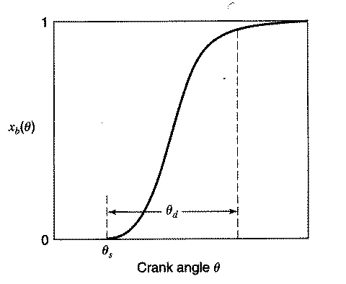
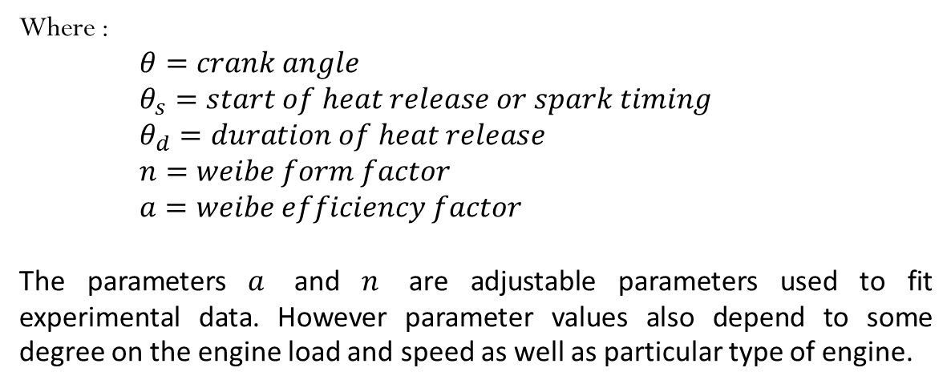
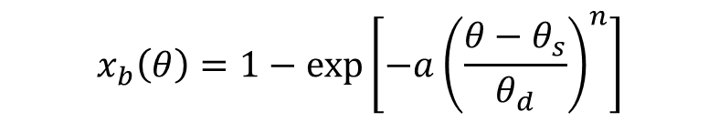
HEAT RELEASE FRACTION:
$$x_{b}\left(θ\right)=1−exp\left[−a{\left(\frac{θ−θ_{s}}{θ_{d}}\right)}^{n}\right]$$
Where :
$θ=crank angle$
$θ_{s}=start of heat release or spark timing$
$θ_{d}=duration of heat release$
$n=weibe form factor$
$a=weibe efficiency factor$
The parameters $a$ and $n$ are adjustable parameters used to fit experimental data. However parameter values also depend to some degree on the engine load and speed as well as particular type of engine.

Slide 4
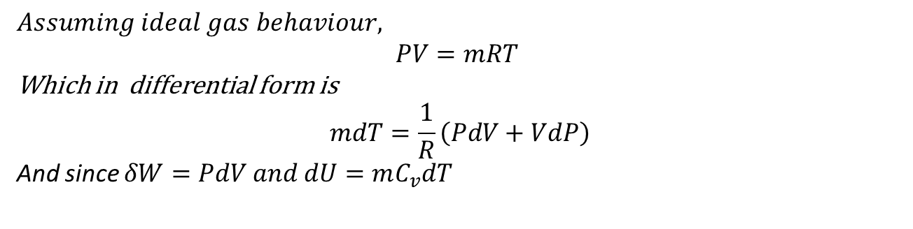
HEAT RELEASE FRACTION:
A typical heat release curve consists of an initial spark ignition phase, followed by a rapid burning phase and ends with burning completion phase.
The rate of heat release as a function of crank angle is:
Applying the first law to the closed system containing the gas in the cylinder for a small crank angle change, d$θ,$
$$Assuming ideal gas behaviour,$$
$$PV=mRT$$
Which in differential form is
$$mdT=\frac{1}{R}\left(PdV+VdP\right)$$
And since $δW=PdV and dU=mC_{v}dT$

Slide 5
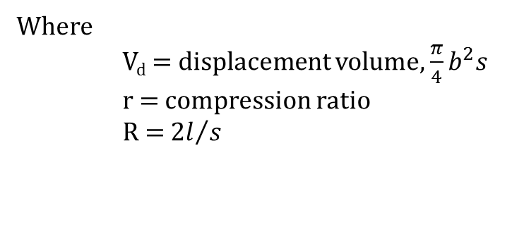
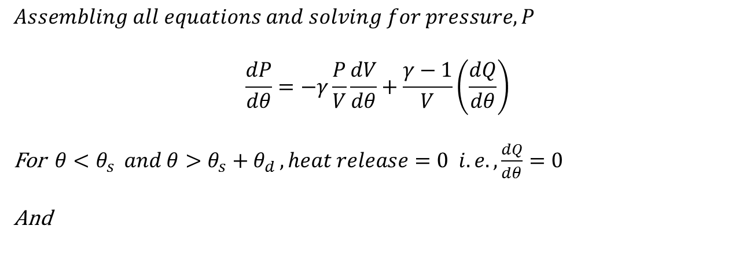
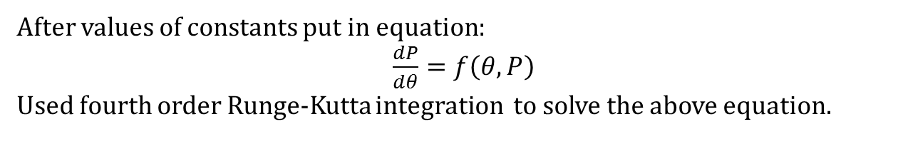
$$Assembling all equations and solving for pressure, P$$
$$\frac{dP}{dθ}=−γ\frac{P}{V}\frac{dV}{dθ}+\frac{γ−1}{V}\left(\frac{dQ}{dθ}\right)$$
For $θ<θ_{s } and θ>θ_{s}+θ_{d }, heat release=0 i.e. ,\frac{dQ}{dθ}=0$
And
Upon differentiation:
Where
V_{d} = displacement volume, $\frac{π}{4}b^{2}s$
r = compression ratio
R = 2$l/s$
After values of constants put in equation:
$\frac{dP}{dθ}=f\left(θ, P\right)$
Used fourth order Runge-Kutta integration to solve the above equation.

Slide 6
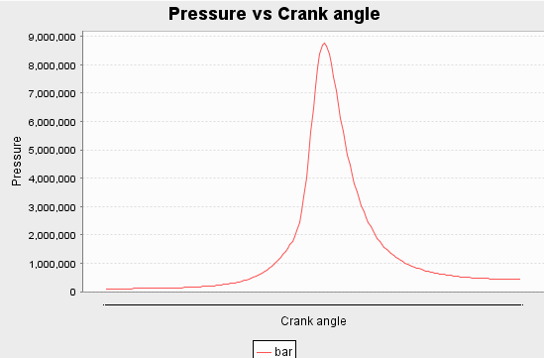
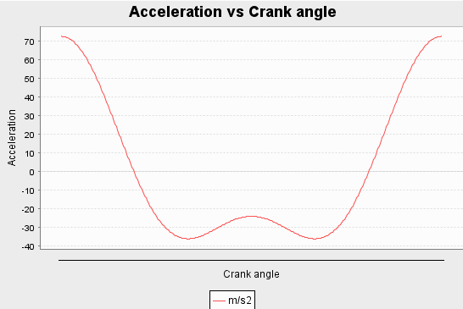
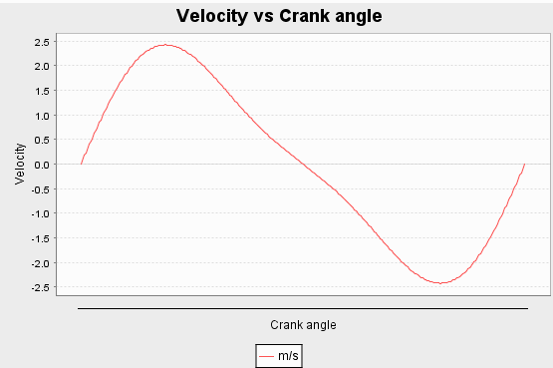
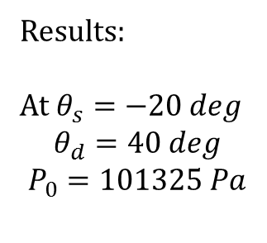
Results:
At $θ_{s}=−20 deg$
$$θ_{d}=40 deg$$
$$P_{0}=101325 Pa$$

